Slide 1
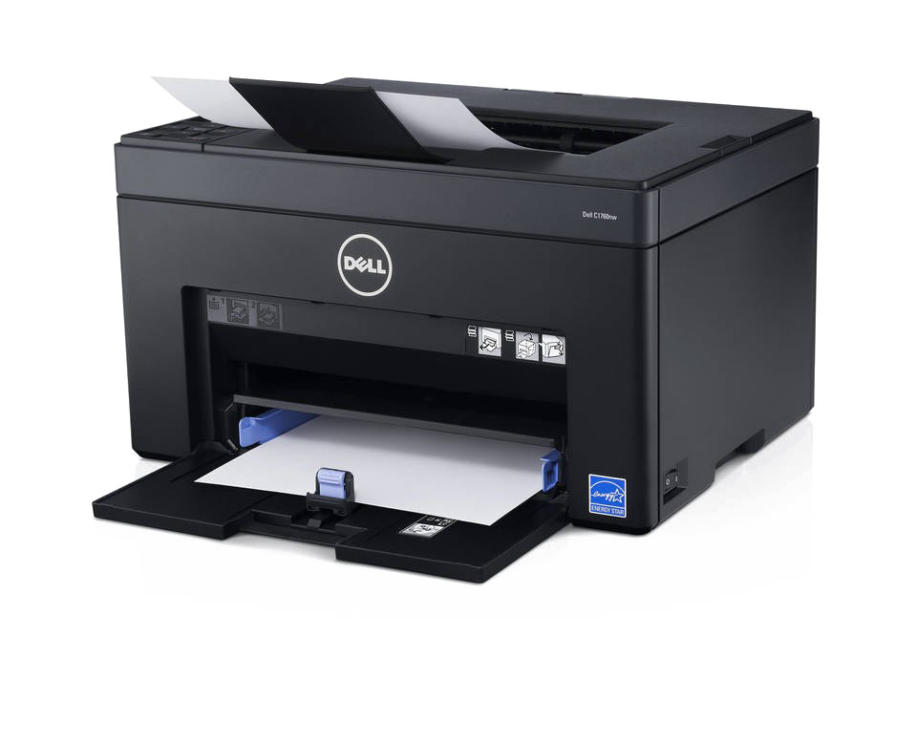
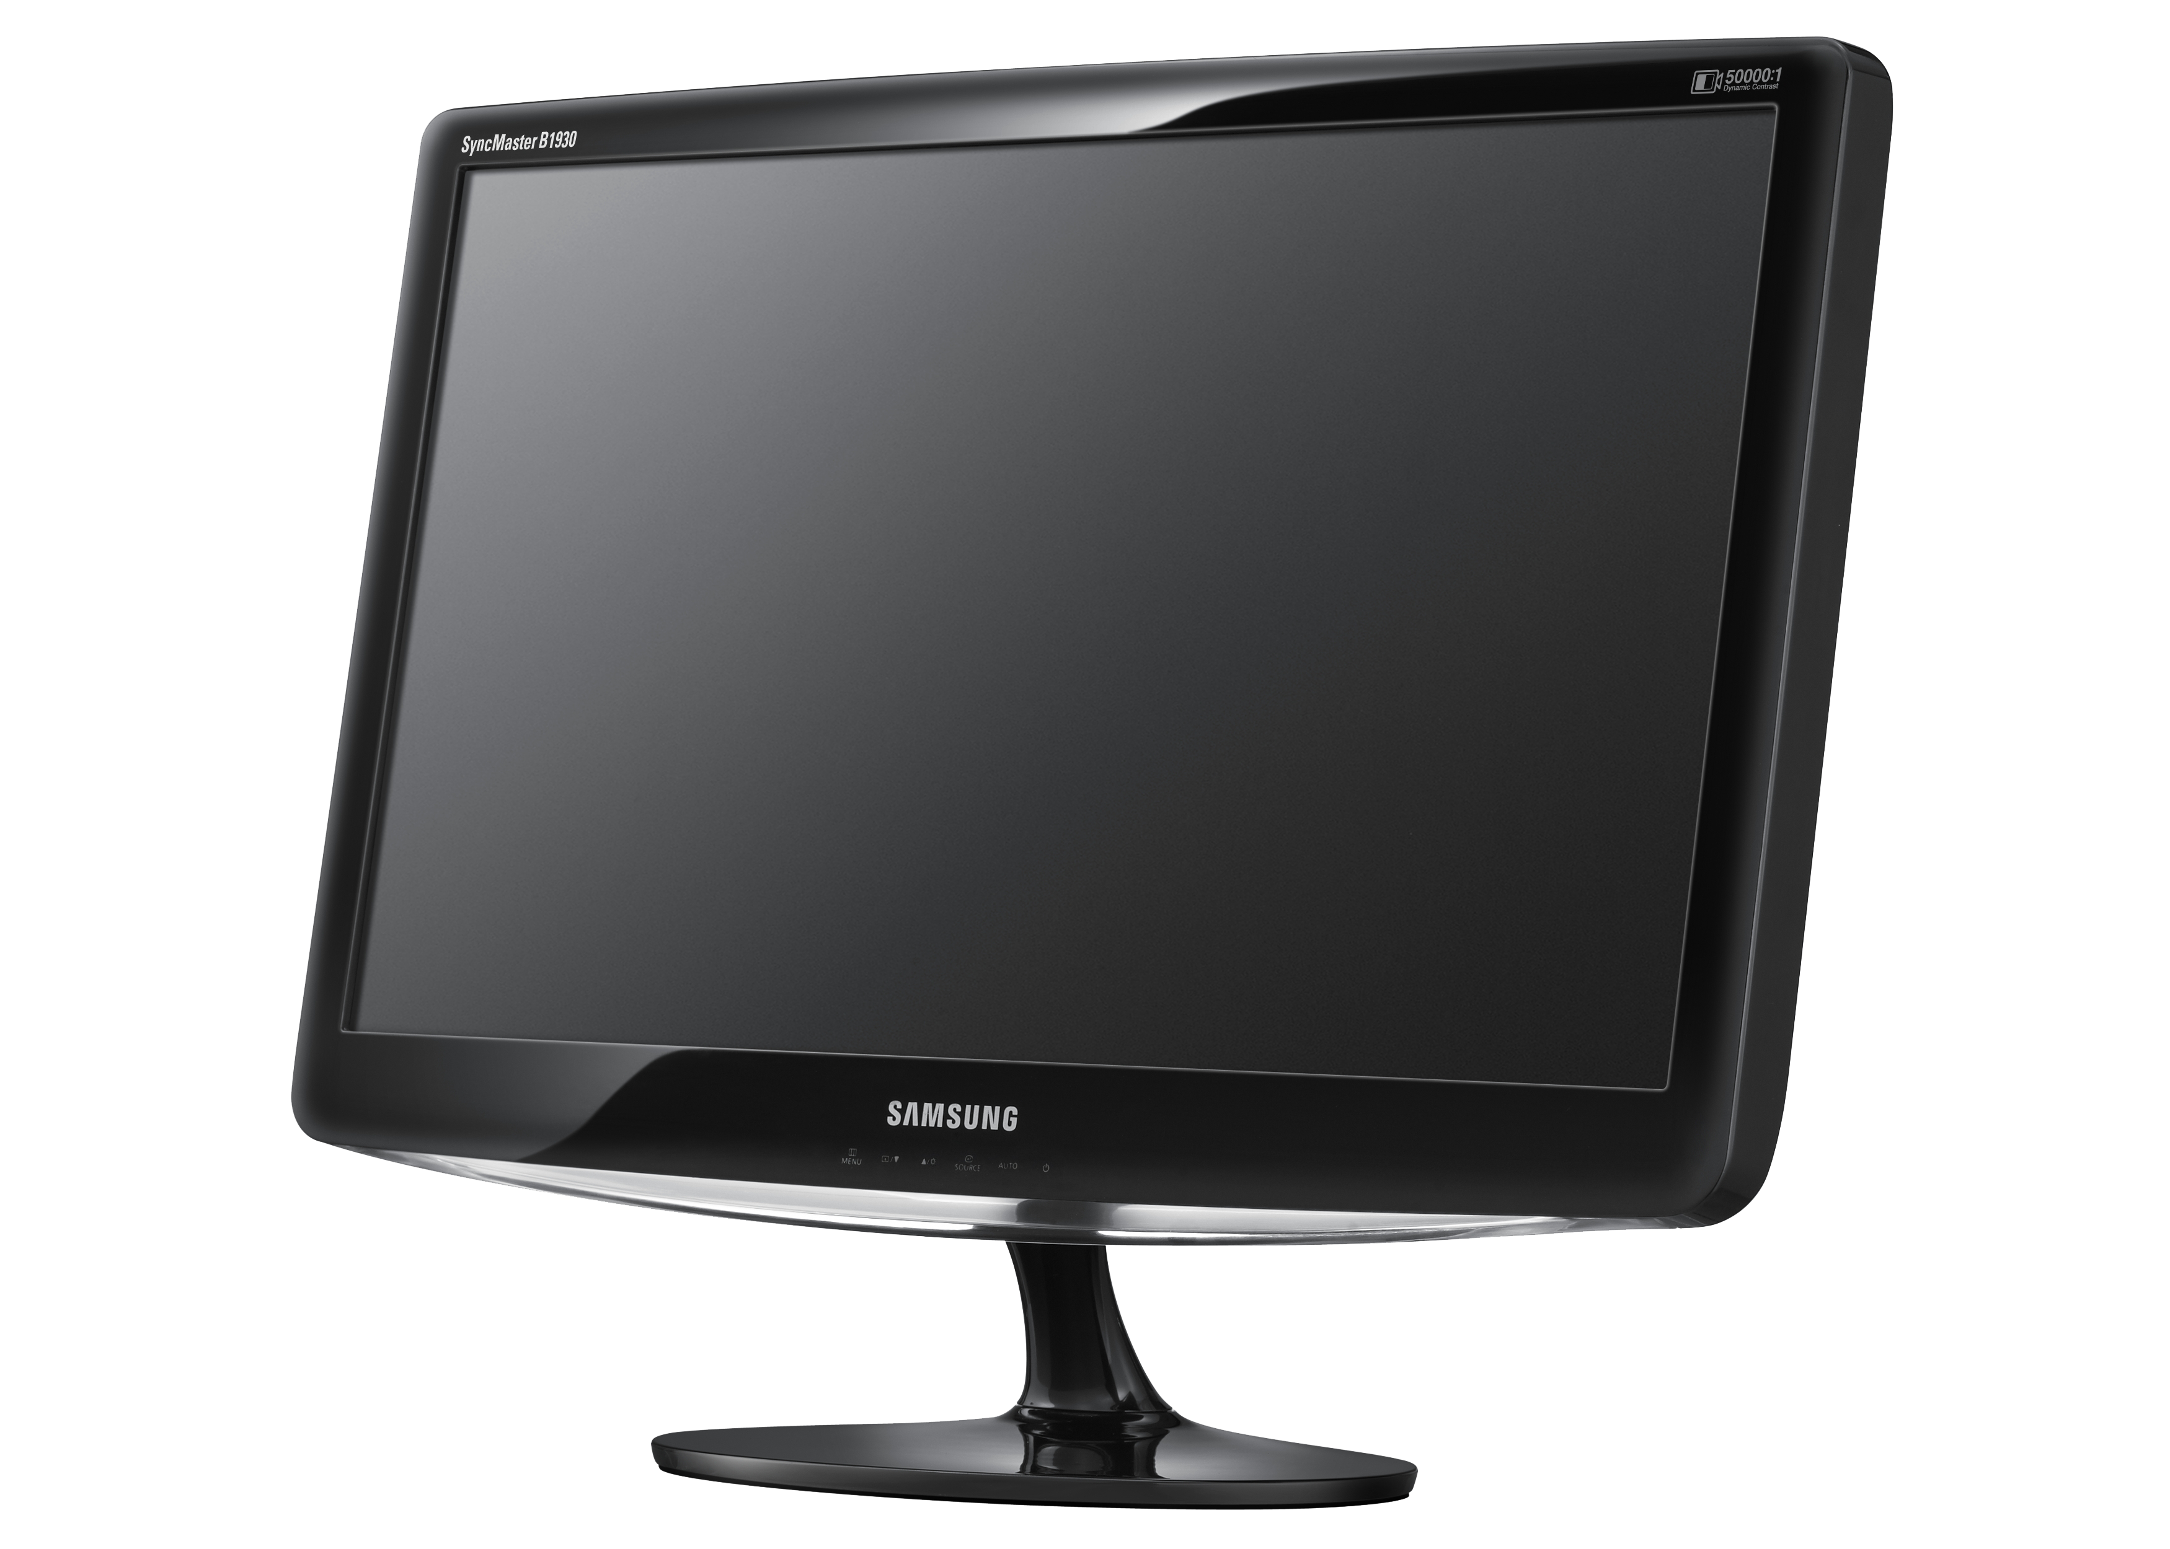


Electronics
Recycling Day
FREE
Saturday, April 12th, 2025
SCMUA Solid Waste Facility
34 Route 94, Lafayette
9:00 am to 2:00 pm
Accepted Electronics:
Cell Phones
CD, DVD and VCR Players
Copiers & Scanners
Cameras
Computer Mice & Keyboards
Desktop or Personal Computers
Desktop Printers
Desktop Fax Machines
E-Book Readers
Electronic wires, cabling, chargers
Laptops & Tablets
MP3 Players
Modems
Stereos, Radios & Speakers
Televisions & Flat Screens
* No Appliances Please*

