Slide 1
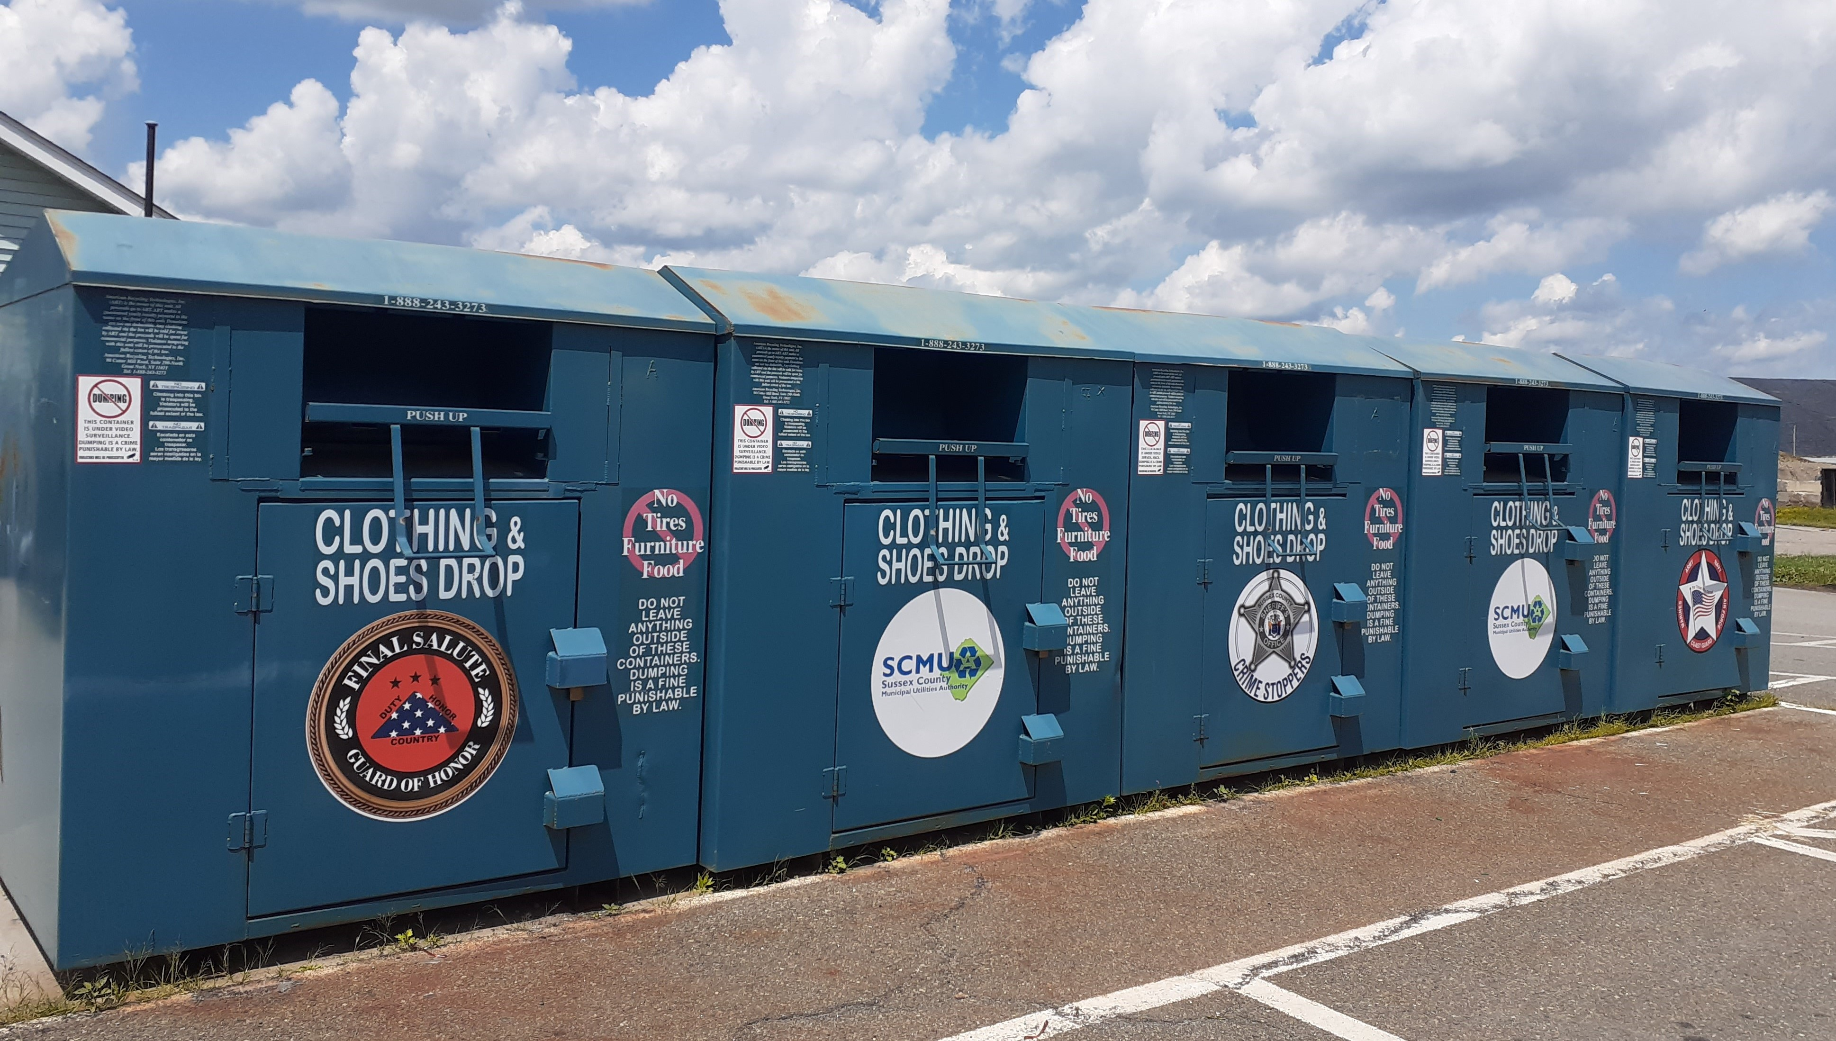
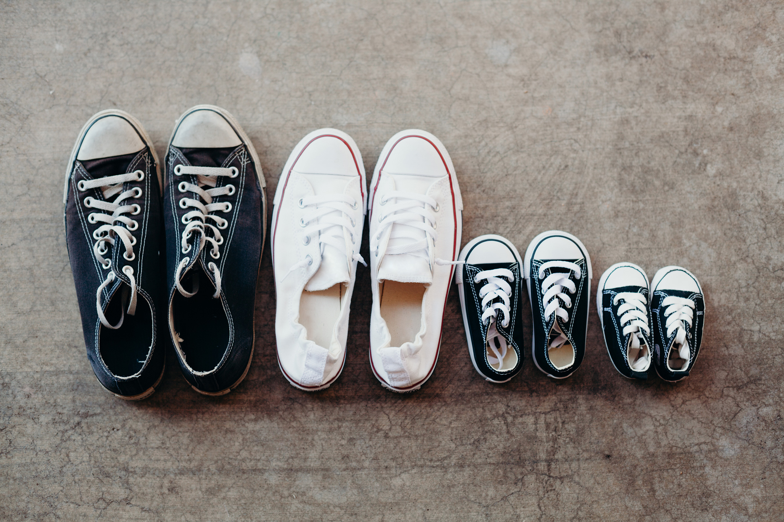
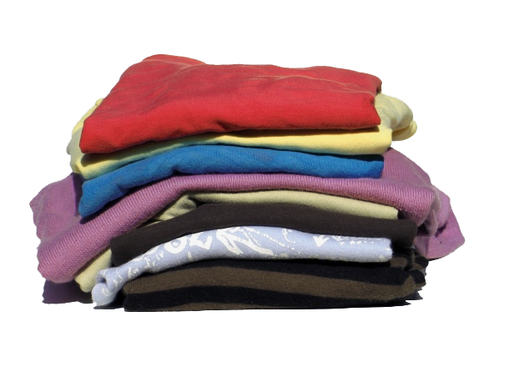
Clothing & Textile Recycling
Sussex County residents may recycle all textiles (woven and non-woven fabrics) at the SCMUA Recycling Center including:
Clean Clothing
Shoes
Handbags
Tablecloths
Sheets
Comforters
Bedspreads
Towels
Revenue from the clothing recycling program benefits the following local organizations:
Sussex County Crimestoppers
Northern New Jersey Veterans Memorial Cemetery
Final Salute Guard of Honor
Sussex County Municipal Utilities Authority
For more information:
SCMUA: 973-579-5998 www.scmua.org
34 Route 94, Lafayette, NJ 07848

